Slide 1

Robotic arm model
PRESENTATION
By
Anshuman (PRN:2114110433)
Utkarsh Maurya (PRN:2114110490)
Mayank Mankar (PRN:2114110488)
B.Tech (Electronics) Sem-VIII
Under the guidance of
Dr. Arundhati A. Shinde
Department of Electronics & Communication Engineering
Bharati Vidyapeeth (Deemed to be University),
College of Engineering
Pune.

Slide 2
CONTENT
Abstract
Introduction
Literature Survey
Objectives
Components
Block Diagram
Circuit Diagram
Flowchart
Robotic Arm Model Structure
Conclusion
Future scope
References

Slide 3

ABSTRACT
Designed a simple pick-and-place robotic arm for small-scale and educational applications.
Controlled using an Arduino Mega 2560 and SG90 servo motors.
Capable of basic object manipulation tasks using a joystick-controlled interface.
Built to be cost-effective and easy to assemble, using materials like acrylic
Demonstrates fundamental concepts of robotics, automation, and embedded systems.
Serves as a learning platform with scope for future development in advanced robotics.

Slide 4

Introduction
Robotics and automation play a vital role in enhancing productivity, precision, and safety.
Robotic arms are used across industries like:
Automotive – for welding and assembling.
Electronics – for component placement.
Healthcare – for surgical assistance and rehabilitation.
These systems offer flexibility, repeatability, and can operate in hazardous environments.

Slide 5
Purpose and Scope of the Project
The goal of this project is to design a low-cost pick-and-place robotic arm for educational use.
Built using Arduino Mega 2560, SG90 servo motors, and joystick modules for manual control.
The arm structure is made from acrylic, making it affordable and easy to assemble.
Focuses on teaching core concepts of:
Embedded systems
Servo motor control
Mechanical movement
Serves as a hands-on learning tool to connect classroom theory with real-world applications.
Acts as a foundation for future innovations in automation and robotics.

Slide 6
Literature Survey
“Design and Development of a Robotic Arm” – B. K. Kumar et al.
Developed a 5-DOF robotic arm to assist elderly and specially-abled individuals with tasks like feeding. Used lightweight aluminum structure, Arduino Mega 2560 for control, and MATLAB for kinematic modeling. A GUI was built using Processing3 for intuitive control. → Focus: Assistive robotics with precision control for mobility-challenged users.
“Pick and Place Robotic Arm: A Review Paper” – Sharath Surati et al.
Reviewed AI-integrated robotic arms used in sorting, welding, assembly, and inspection. Highlighted use of Arduino and servo motors for motion control, combined with real-time object detection and feedback systems. → Focus: Industrial automation using AI-enhanced robotic arms for dynamic environments.
“Robotic Arm Movement Grasping System Based on MYO” – Ye Wei et al.
Introduced gesture-based control using the MYO armband, which captures sEMG and IMU signals. These signals were processed using filtering and machine learning algorithms to translate human arm movements into robotic arm gestures. → Focus: Prosthetics and rehabilitation with real-time, intuitive human-machine interaction.

Slide 7
“Design and Research of an Automatic Grasping System for a Robot Arm” – Xiaofan Liu et al.
Implemented Kinect-based vision capture and used deep learning (ResNet50 with ELU activation) for gesture classification. Kalman filtering enabled accurate, real-time motion tracking with 96–98% recognition accuracy. → Focus: Vision-based gesture recognition for adaptive robotic grasping in complex tasks.
“Developing and Researching a Robotic Arm for Public Service and Industry” – Florin Covaciu et al.
Focused on creating an accessible software interface with real-time monitoring, simplifying complex robotic control. Designed for manufacturing and healthcare sectors, it allowed users of varying skill levels to operate robotic systems efficiently. → Focus: Public service and user-friendly robotic interfaces to reduce operator error.
“Robotic Arm Control System Based on AI Wearable Acceleration Sensor” – Liang Chen et al.
Designed a robotic control system using wearable MEMS acceleration sensors and a PI control algorithm. Included temperature sensing at the gripper and wireless communication for mobility and safety in sensitive tasks. → Focus: Wearable AI tech enabling adaptive control in delicate industrial and medical operations.

Slide 8
objectives
Demonstrate Automation Concepts Provide a hands-on learning tool to understand basic principles of robotics and automation.
Cost-Effective Prototyping Design a working robotic arm using affordable components like Arduino, servo motors, and cardboard.
Motor Control Integration Control multiple servo motors using Arduino and joystick inputs for real-time movement.
Lightweight Mechanism Design Develop a structure capable of picking and placing lightweight objects with stability and accuracy.
Theory to Practical Implementation Apply electronics, programming, and mechanical concepts in building a fully functional robotic arm.

Slide 9
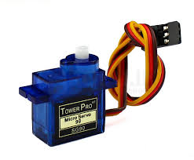
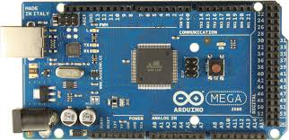
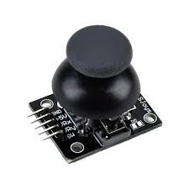
components
Servo Motors (SG90) – 4 Units
Provide rotational movement up to 180°
Control various joints: base rotation, elbow, wrist, and gripper
Operate on PWM signals from the Arduino
Arduino Mega 2560
Main microcontroller board for the project
Based on the ATmega2560 with 54 digital I/O pins and 16 analog inputs
Processes input signals from joysticks and outputs control signals to servos
Chosen for its higher pin count and memory over the Arduino Uno
Dual Axis XY Joystick Modules – 2 Units
Allow manual control of the robotic arm's movement
Each joystick provides two axes of movement (X and Y)
Sends analog values to Arduino for translating into servo angles

Slide 10
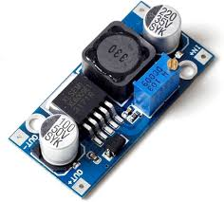
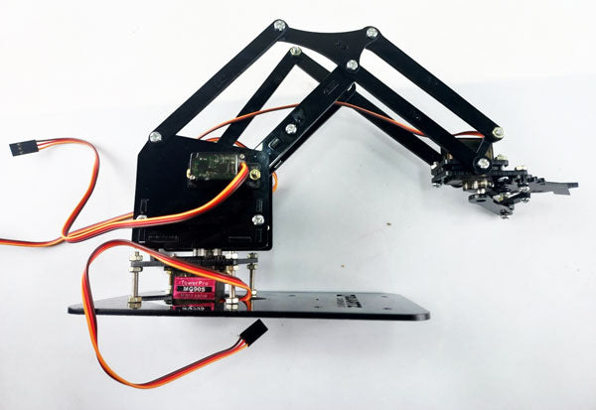
Current Booster
Ensures stable voltage and current to all connected components
Prevents power drop when multiple servos operate simultaneously
Essential for reliable and smooth motor function
Robotic Arm Kit (Chassis/Frame)
Mechanical parts (mostly acrylic) forming the structure of the arm
Provides mounting support for servos and other components
Designed for lightweight object manipulation and easy assembly
USB to USB Cable
12V Adapter
Connecting Wires

Slide 11
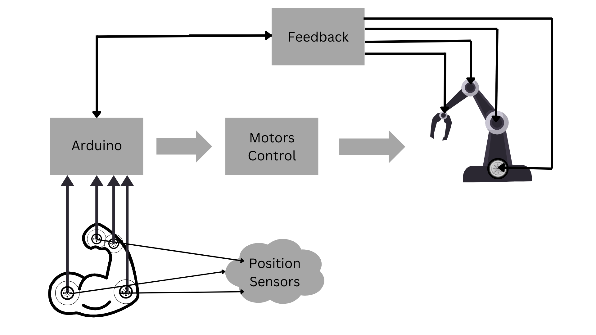
Block diagram

Slide 12
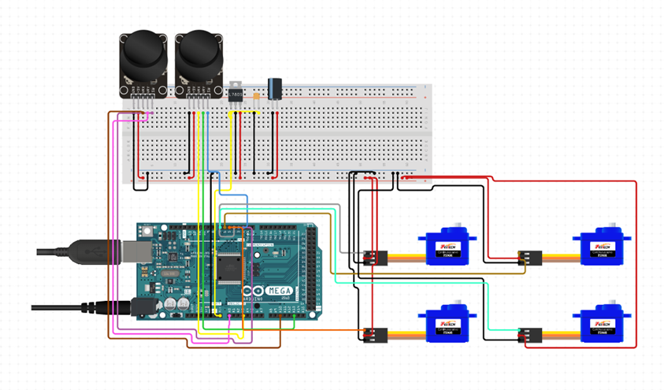
Circuit Diagram

Slide 13
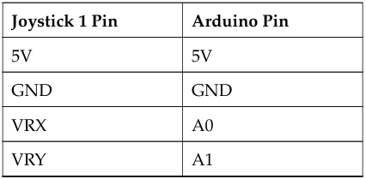
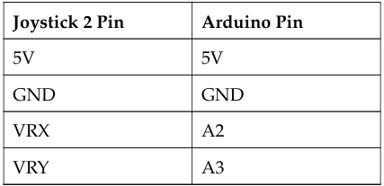
Joystick 1 to Arduino Connections
Joystick 2 to Arduino Connections

Slide 14
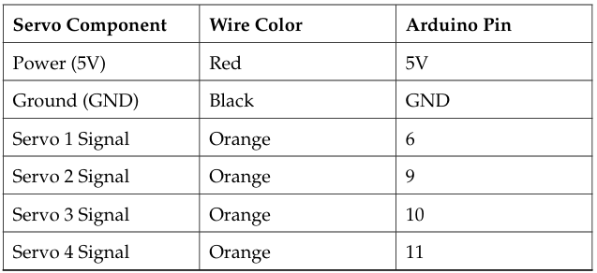
Servo Motor to Arduino Connections

Slide 15
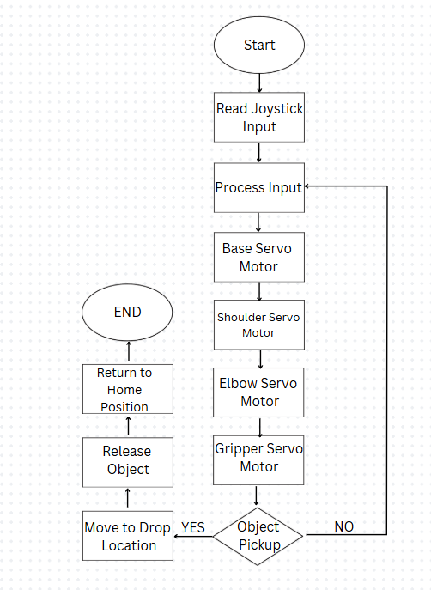
FLOWCHART

Slide 16
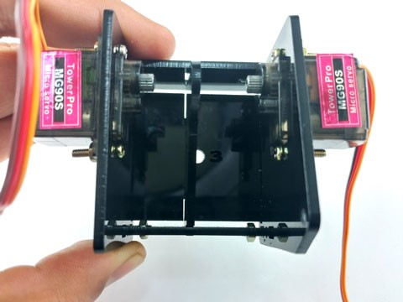
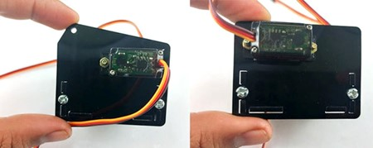
Robotic Arm Model Structure
STEP 1: BOX STRUCTURE ASSEMBLY
Top view:
Side view:

Slide 17
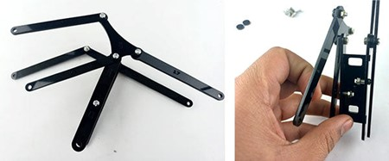
STEP 2: BRIDGE AND CLIPS ASSEMBLY

Slide 18
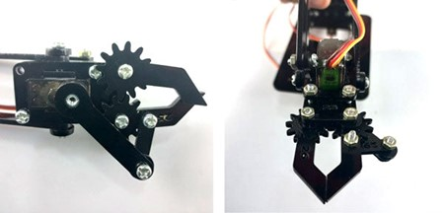
STEP 3: CLIPPER ASSEMBLY

Slide 19
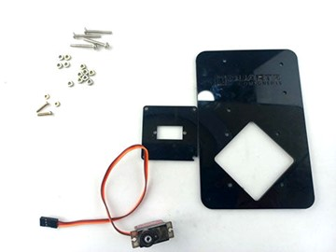
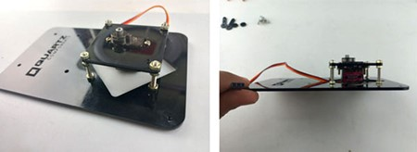
STEP 4: BASE MOUNT ASSEMBLY
Top Perspective
Side Perspective

Slide 20
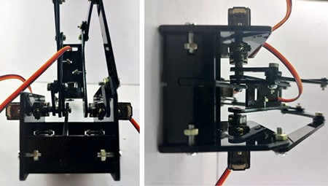
STEP 5: BODY ATTACHMENT

Slide 21
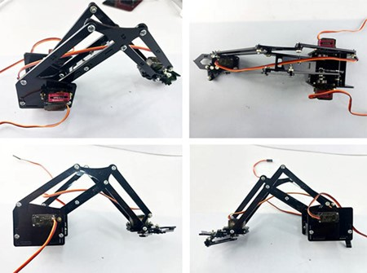
STEP 6: CLIPPER AND BASE MOUNT ATTACHMENT TO THE BODY

Slide 22
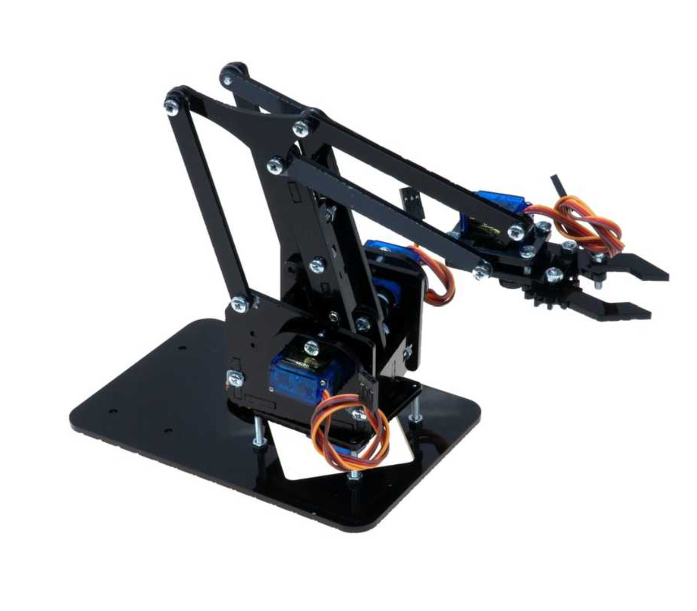
Robotic Arm Base Assembly

Slide 23
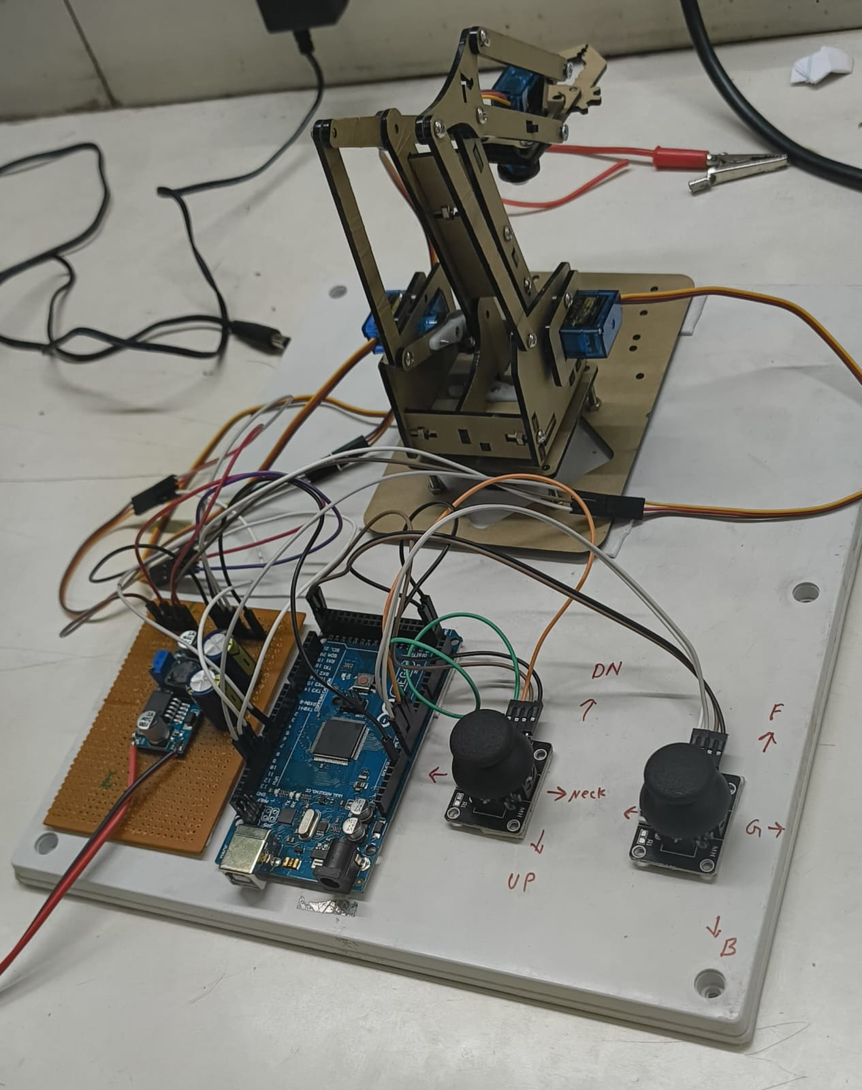
Real Time Implemented Robotic Arm Model

Slide 24
Conclusion
The project successfully demonstrated the development of a low-cost, joystick-controlled robotic arm using Arduino and servo motors.
The arm performs basic pick-and-place tasks, highlighting essential concepts of robotics, motor control, and embedded systems.
The hands-on implementation bridged the gap between theoretical knowledge and real-world application.
It provided valuable insights into kinematics, servo control, circuit integration, and mechanical design.
This model serves as a scalable foundation for advanced automation, AI-based robotics, and industrial-grade systems.

Slide 25
Future scope
Integration with Computer Vision and AI Enable the robotic arm to detect, classify, and track objects using OpenCV and machine learning, transforming it from manual to intelligent automation.
Wireless and IoT-Based Control Incorporate Wi-Fi/Bluetooth modules (e.g., ESP8266 or HC-05) to allow remote operation via mobile or web-based platforms, aligning with Industry 4.0 trends.
Autonomous Pick-and-Place System Replace manual joystick input with sensor-based or vision-based automation, enabling the arm to operate without human intervention.
Real-Time Feedback and Error Correction Use encoders, pressure sensors, and feedback loops to enhance accuracy, repeatability, and safety in object manipulation tasks.
Scalability for Industrial Applications Redesign the system using high-torque servos and robust frames for deployment in automated assembly lines, packaging, or warehouse systems.

Slide 26
References
B. K. Kumar, et al. “Design and Development of a Robotic Arm”, IEEE International Conference on Circuits, Controls, Communications and Computing (I4C), 2016.
Sharath Surati, et al. “Pick and Place Robotic Arm: A Review Paper”, International Research Journal of Engineering and Technology (IRJET), Vol. 8, No. 2, 2021.
Ye Wei and D. Jia “Research on Robotic Arm Movement Grasping System Based on MYO”, Journal of Physics: Conference Series, Vol. 1754, 2021.
Xiaofan Liu, et al. “Design and Research of an Automatic Grasping System for a Robot Arm Based on Visual Image Capture Technology”, Frontiers in Mechanical Engineering, 2024.
Florin Covaciu, et al. “Developing and Researching a Robotic Arm for Public Service and Industry”, Proceedings (MDPI), Vol. 63, No. 1, 2020.
Liang Chen, et al. “Robotic Arm Control System Based on AI Wearable Acceleration Sensor”, Mathematical Problems in Engineering, Vol. 2021, 2021.

Slide 27
THANK YOU

